Slide 1
A Ransomware Experience
Date: December 2020

Slide 2
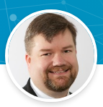
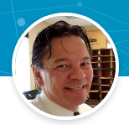
Presented by
Eric Grendell
VP of IT Operations & Infrastructure
HealthPoint
Harald Upegui
Information Security Officer
HealthPoint

Slide 3

There was a Security Plan
HealthPoint had planned enhancements to its Information Security program to further protect its infrastructure and data.
Part of the security plan included implementation or configuration of the following elements:
  Security Operations Center
  Multi Factor Authentication
  Exchange in the cloud.
  Enterprise Patch management.
Notes:
Eric

Slide 4


Day 1 – Thu Jan 23, 2020
Business as usual in the morning until …
  One Phishing Email warning came in.
  Then another one
  Then one more
  Within few minutes, a lot of warnings came in
Notes:
Harald

Slide 5
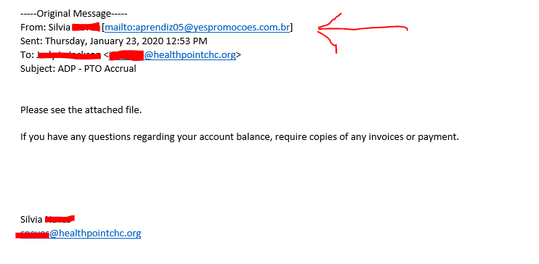
Day 1 – Thu Jan 23, 2020
The Phishing email looked extremely real.
  It used known text from previous emails.
Notes:
Harald

Slide 6
Day 1 – Thu Jan 23, 2020
Remediation Steps.
  Sent communication to all users of suspicious emails.
  Shutdown ground zero computer
  Updated antivirus software
  Blocked source IP’s for email sender
  Monitored network
Observations
  Over 80 external IP address were blocked.
  Malicious emails stopped coming around 6 pm.
  No activity of malware distribution was detected
Notes:
Harald

Slide 7
Day 2 – Fri Jan 24, 2020
Events.
  New wave of emails started to arrive around 7 am.
  Notifications of possible malicious files were reported.
  Users reported suspicious emails.
  Some users clicked on links or attachments.
  Some computers become unresponsive or slow.
Notes:
Eric

Slide 8
Day 2 – Fri Jan 24, 2020
Remediation Steps
  Sent communication to all users of suspicious emails.
  Updated Antivirus rules and policies.
  Shutdown Email server.
  Blocked additional source IP’s for email senders.
  Monitored network.
Notes:
Eric

Slide 9
Day 2 – Fri Jan 24, 2020
Observations
  Over 50 external IP address were blocked.
  Signs of Malware were detected but not encryption.
  Malicious emails stopped coming around 6 pm.
Notes:
Eric

Slide 10
Day 3 – Sat Jan 25, 2020
Events
  Users were not able to connect to network.
  Email communication was down.
  Found signs on encryption in several servers.
  Communication between sites was affected.
  Electronic Medical Record software was not available from the sites
Notes:
Harald

Slide 11
Day 3 – Sat Jan 25, 2020
Remediation Steps
  Sent communication to Senior Leadership.
  Assessed damage
  Shutdown backup servers
  Called in All Hands-On Deck
  Started recovery of systems from backup
Notes:
H

Slide 12
Day 3 – Sat Jan 25, 2020
Observations
  Ransomware was smart enough to start encryption during off hours.
  It is going to be a long weekend !!!
Notes:
H

Slide 13
Day 4 – Sun Jan 26, 2020
Events
  Reinfection of recovered servers
Remediation Steps
  Switched communication to personal email and texting.
  Isolated entire network.
  Imaged local PC’s in Control Center area to set clean recovery state.
  Recovered servers from snap shots, with NIC off.
  Reset passwords for users and admin accounts.
Notes:
E

Slide 14
Day 4 – Sun Jan 26, 2020
Observations
  Rebooting servers activated the encryption process.
  It is going to be a long Quarter !!!
Notes:
E

Slide 15
Day 5 and On
Events
  No additional events of reinfection were detected.
Remediation Steps
  Daily Progress meetings.
  Halted incoming email for over 30 days.
  Hired Forensic company to investigate and produce summary report.
  Replaced over 600 hard drives.
  Saved infected hard drives as evidence (physical and virtual).
  Segregated connectivity between networks.
  Deployed new solutions to enable users and protect the network.
Notes:
H

Slide 16


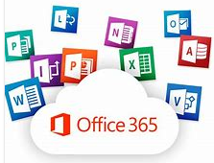



Day 5 and On
New Solutions
  Configured and Deployed VDI on the cloud.
  Completed deployment of M365 to all users.
  Converted PC’s to Igel Operating System
  Deployed Enterprise Patch Management system.
  Adapted Managed Security Operations Center
  Deployed Enterprise MFA and SSO Solution
Notes:
H

Slide 17


Summary and Lessons Learned
All it took was one email.
Backup, backup, backup.
Patch, patch, patch
Extremely smart malware.
Effective but Very costly user awareness training
Segment network
Have a plan, practice, and be ready (Not if but when)
Notes:
E

Slide 18
Summary and Lessons Learned
It was a long year and counting !!!
Notes:
E

Slide 19
A New Threat
Events
  Malicious activity was reported by the SOC
  Power Shell Empire activity was seeing in the network towards the end of March 2021
  Malicious activity was focused at night time
  Password dumping was present.
Notes:
H

Slide 20
A New Threat
Remediation Steps
  Worked with SOC center to identified source of attack.
  Blocked suspicious external IP Address
  Notified users of new malicious activity.
  Reset Administrator level passwords.
  Shutdown servers overnight.
  Contracted Incident Response company to help investigate and address malware threat.
  Deployed Arctic Wolf agents and Endpoint Detection and Response (EDR) software to all Windows machines.
  Isolated management of Domain controllers
  Created additional segregation for Administrative accounts.
  Disabled Power Shell via GPO
Notes:
E

Slide 21
Summary and Lessons Learned II
Threat was identified at early stages
Recent security enhancements paid off
Team work slowed down the surface attack
Quicker decision making was a key component
Additional work to be done
Silver bullet not available yet
Plan, practice, and be ready (Not if but when)
Notes:
H

Slide 22
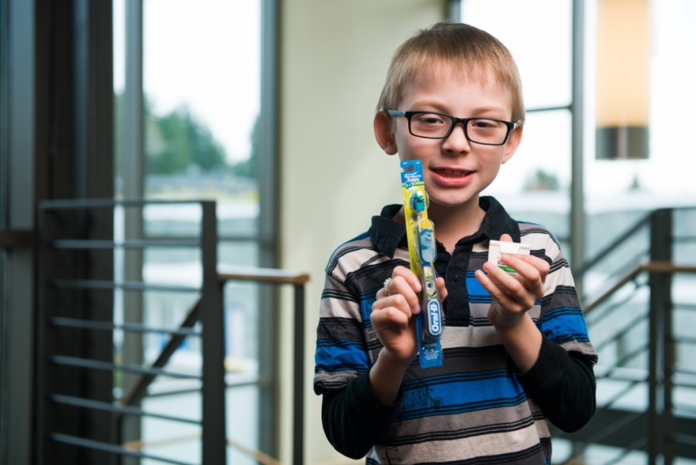

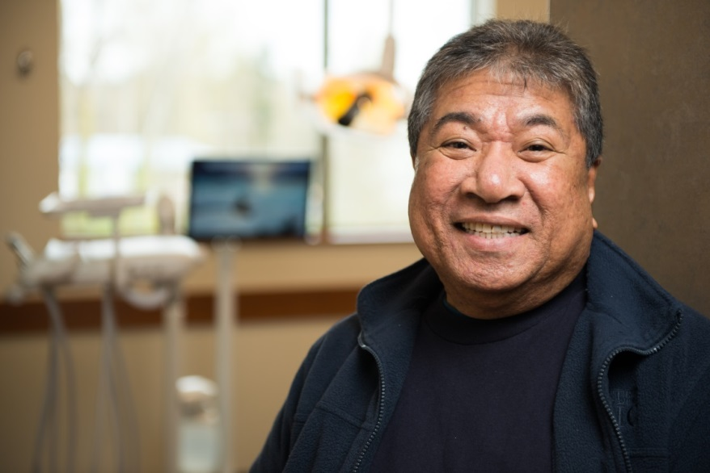
Everyone Deserves Great Care

