Slide 1
Protesters at the Workplace
Linda A. Simpson
Security Manager
Planned Parenthood of the Great Northwest, Hawai’i, Alaska, Indiana, Kentucky (PPGNHAIK)

Slide 2
Introduction
Protesters at the workplace.
This presentation is not about taking sides with protesters or whether you agree or disagree with the issue. It’s about your safety when encountering a protest event.
Linda Simpson retired after 25 years as a Law Enforcement Professional with another 20 years of private security experience at Microsoft and Planned Parenthood.
Notes:
How presentation will benefit audience: Adult learners are more interested in a subject if they know how or why it is important to them.
Presenter’s level of expertise in the subject: Briefly state your credentials in this area, or explain why participants should listen to you.

Slide 3
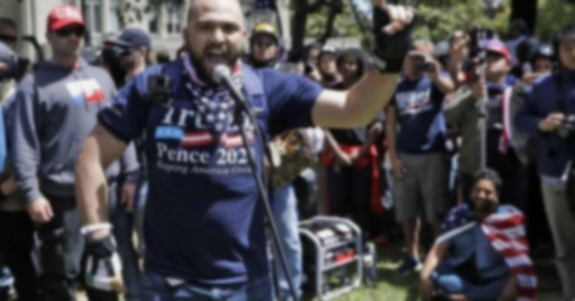
Training Outline
Lesson 1: Overview and history of protests.
Lesson 2: Protester goals and tactics.
Lesson 3: Strategies to stay safe.
Notes:
Lesson descriptions should be brief.

Slide 4
Course Objectives
Understanding that protesting is a constitutional right.
Recognizing problems in advance.
Learning strategies to remain safe.
Notes:
Example objectives
At the end of this lesson, you will be able to:
Save files to the team Web server.
Move files to different locations on the team Web server.
Share files on the team Web server.

Slide 5
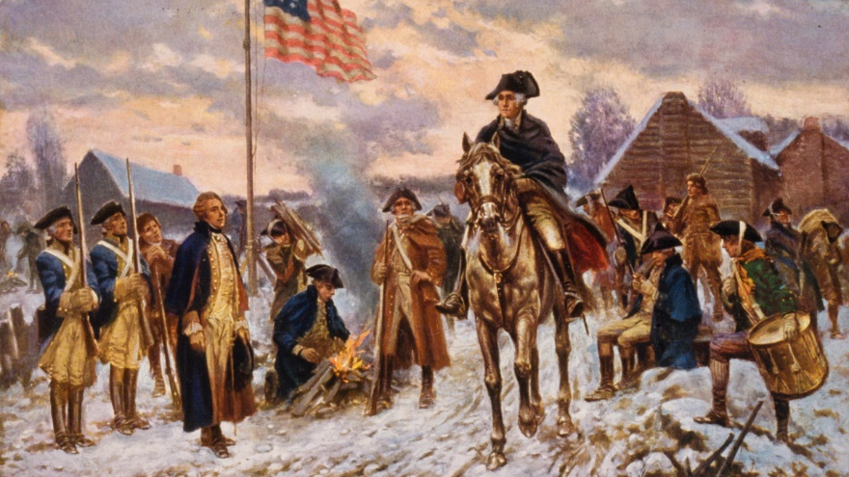
LESSON 1: OVERVIEW AND HISTORY OF PROTESTING
OUR COUNTRY WAS BORN OUT OF PROTEST AND HAS A HISTORY OF PROTEST MOVEMENTS

Slide 6
OUR COUNTRY WAS BORN OUT OF PROTEST AND HAS A HISTORY OF PROTEST MOVEMENTS
SOME NOTABLE DATES AND EVENTS
Boston Tea Party: Dec. 16, 1773, Boston, Massachusetts
Abolitionist Movement: 1830-1865
Women’s Suffrage: 1913 Washington, D.C.
Anti-War Movement: 1967-1972
Stonewall Riots: 1969 New York
Occupation of Alcatraz: 1969 to 1971 San Francisco Bay, California
Million Man March: 2000 Washington D.C.
The March for Our Lives March 24, 2018, Washington, D.C., with other protests led worldwide.
George Floyd Protests 2020 Nationwide
Not an exhaustive list

Slide 7
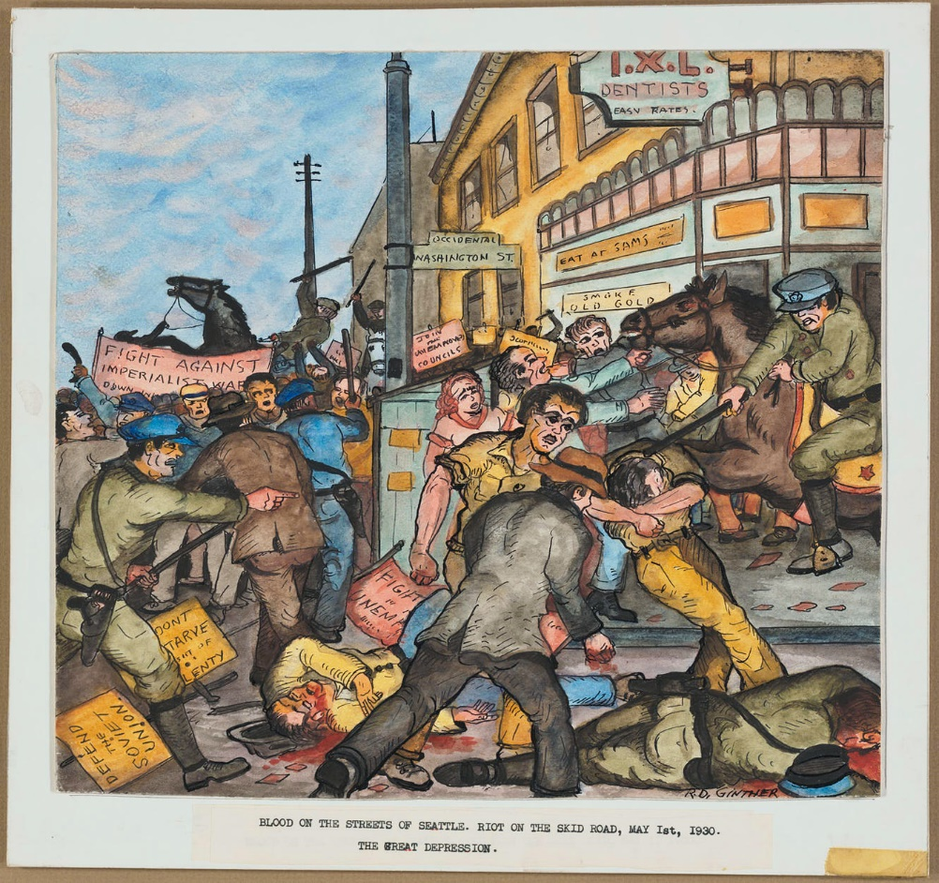
Communist bashing on Skid Road (May 1, 1930)
SEATTLE HAS A HISTORY OF PROTESTS AND RIOTS
Abortion Rights
Anti Abortion Rights
ANTIFA
BLM
Defund the Police
Immigrant Rights
Labor rights
WTO
Anti War Demonstrations
May Day
Rent Reform
Political
Race inequality
Climate Change
Anti-globalization
Civil Rights
LBGTQ+ Rights
Occupy protests
White Supremacist groups
A FEW NOTABLE EVENTS
George Floyd / BLM 2020
Yiannopoulos madness 2017
Mardi Gras mayhem of 2001
WTO 1999
Alki Beach Youth riot of 1969
Eruption on the Ave 1969
The waterfront riots of 1934
Communist bashing on Skid Road (May 1, 1930)
Far from an exhaustive list
Reference: A short, violent history of Puget Sound uprisings, protests and riots | Crosscut
https://crosscut.com/2020/06/short-violent-history-puget-sound-uprisings-protests-and-riots

Slide 8
WHAT ARE PROTESTS?
An event or action where people gather with others to publicly express their opinions about something that is happening in society with the goal of enacting change.
PROTEST CAN TAKE THE FORM OF
Marches
Sit-ins
Boycotts
Civil Disobedience

Slide 9
Protesters’ Rights
The First Amendment protects the right to assemble and express views through protest.
When lawfully present in any public space, protesters have the right to photograph anything in plain view.
On private property, the owner may set rules related to photography or video.
Reference: Know Your Rights | Protesters’ Rights (aclu.org)
Protester rights are strongest in “traditional public forums,” such as streets, sidewalks, and parks.
Protesters likely have the right to speak out on public property, if they are not blocking access to the building or interfering with other purposes the property was designed for.
Private property owners can set rules for speech on their property.
The government may not restrict speech on your own property or with the consent of the property owner.

Slide 10
WHY PROTEST
By gathering, demonstrators draw attention to themselves and their causes.
Media attention is not only frequently sought but is paramount.
At illegal gatherings, however, protesters disrupt the peace—fueled often with the intent to make protester removal by law enforcement difficult or dangerous.
Tactical Theory: A protester tactic can be anything that impedes normal activity at a public place, often in violation of the law, thereby, creating civil disorder.
Tactics range from banners to occupation to locking devices to the marking of law enforcement. Protesters rely on tactics to make their presence known to occupy or block key areas, such as buildings and roadways.

Slide 11
ADDITIONAL ADVOCACY METHODS:
Legislation
Public awareness campaigns
Raising funds
Gaining support through social media
Other methods
PROTESTS CAN INCLUDE
speeches
music
chanting
performance art
poetry
Use of symbols
holding signs
confronting people
occupying a specific building or space
Assembling near symbols and in places of significance

Slide 12
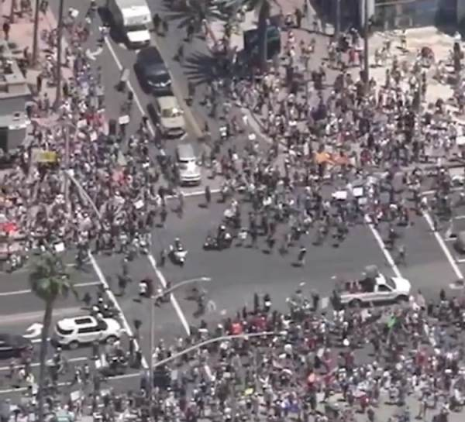
Crowd situations
Typically involves peaceful participants legally exercising their First Amendment right to free speech regarding a cause.
Lawful activities can include speeches, marches, celebratory events, demonstrations, rallies, picketing, public assemblies, and protests.
By gathering, demonstrators draw attention to themselves and their causes.
Media attention is frequently sought.
At illegal gatherings, however, protesters disrupt the peace—fueled often with the intent to make protester removal by law enforcement difficult or dangerous.
Outside groups may infiltrate a protest with a different goal or agenda than the protest group or to disrupt the same.

Slide 13
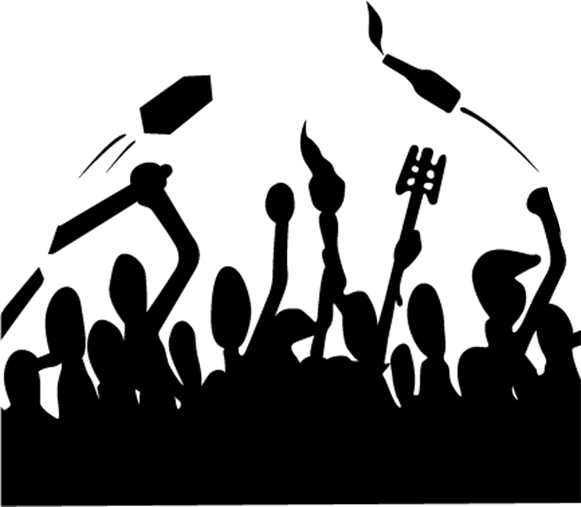
LESSON 2
GOALS AND TACTICS OF PROTESTS

Slide 14
MEDIA ATTENTION
MEDIA
Media Attention. Media attention is paramount to the protesters for making the public aware of their causes, which is something more easily accomplished with the use or protester tactics—the larger the spectacle, the more attention it draws. (Ref. FEMA Field Force Operations, Center for Domestic Preparedness)

Slide 15
MEDIA ATTENTION
SOCIAL MEDIA
Social media has changed the way protests and events are covered
Gives everyone and anyone a platform
May or may not be reported impartially
May be used to create and fabricate “news”

Slide 16
MEDIA ATTENTION
MEDIA
Media Attention. Media attention is paramount to the protesters for making the public aware of their causes, which is something more easily accomplished with the use or protester tactics—the larger the spectacle, the more attention it draws. (Ref. FEMA Field Force Operations, Center for Domestic Preparedness)
SOCIAL MEDIA
Social media has changed the way protests and events are covered
Gives everyone and anyone a platform
May or may not be reported impartially
May be used to create and fabricate “news”
USING A COMBINATION OF THESE METHODS CAN BE AN EXTREMELY EFFECTIVE MEANS OF DELIVERY

Slide 17
Media Attention
Media attention is paramount to the protesters for making the public aware of their causes, which is something more easily accomplished with the use or protester tactics.
The larger the spectacle, the more attention it draws.
In the process, they may take an opportunity to demonstrate the “brutality” of public safety officials, especially law enforcement or similarly highlight issues with the organization being protested and its employee’s.
Protest groups videotape their dramatic demonstrations for online messaging, leading groups to embrace YouTube and/or other social media platforms.
Protester groups upload footage to social media to document activist actions and provide news clips meant to expose perceived wrongdoings before, during, or after a protest.
The goal is frequently to make an event “newsworthy” where the national news media broadcasts the story.

Slide 18
Media Attention
Protesters may attempt to get an employee or representative to speak or otherwise condone their actions voluntarily or by subterfuge and may use a variety of devices:
Hidden cameras
Hidden microphones
Infiltration by a sympathetic person(s) posing as a client or employee
Can be very well organized
Technological devices are now cheap, easy to use and very effective
USING A COMBINATION OF THESE METHODS CAN BE AN EXTREMELY EFFECTIVE MEANS OF DELIVERY

Slide 19
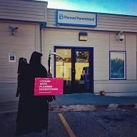
USING SYMBOLS NEXT TO A PLACE OF SIGNIFICANCE IS A FORM OF PROTEST
EXAMPLE
Photos and video were taken of an Anti-Planned Parenthood protester trespassing using theatrics to stage a stunt:
Dressed as the grim reaper
Holding a support Planned Parenthood sign
Standing in front of a Clinic
The footage and photos were used on social media with a false narrative. The goal of the incident going viral did not happen and it failed to get picked up by national legitimate news sources.

Slide 20
COUNTER PROTESTERS
Counter protesters also have free speech rights.
Police must treat protesters and counter protesters equally.
Police are permitted to keep antagonistic groups separated but should allow them to be within sight and sound of one another.

Slide 21
PROTESTER STRATEGIES Example: create confrontation | create newsworthy event
PRO PLANNED PARENTHOOD
Small group older protesters regularly on site.
Protester's approach intoxicated person who has no relationship with PP or protests.
Incident is reported in local news.
Pro Planned Parenthood Counter protester groups report they will come to PP’s defense.
PP Security Manager asks supporters not to counter protest, they decline to agree.
ANTIFA reports they will attend to support those who oppose the Proud Boys.
PP Security Manager contacts law enforcement. Valley Civil Disturbance Unit is activated and a large Police Presence results
OPPOSITION GROUPS
Has been going on for years without incident.
Intoxicated person gets irritated at being bothered and assaults one of the protesters.
Patriot Prayer (group allied with the Proud Boys) reports they will come to defend the pro-life protesters. Their leader is a US Senate candidate.
Proud Boys report they will attend to support Patriot Prayer.
Even becomes a major media event and is covered by Western Washington Broadcast and print media and is eventually picked up nationally.

Slide 22
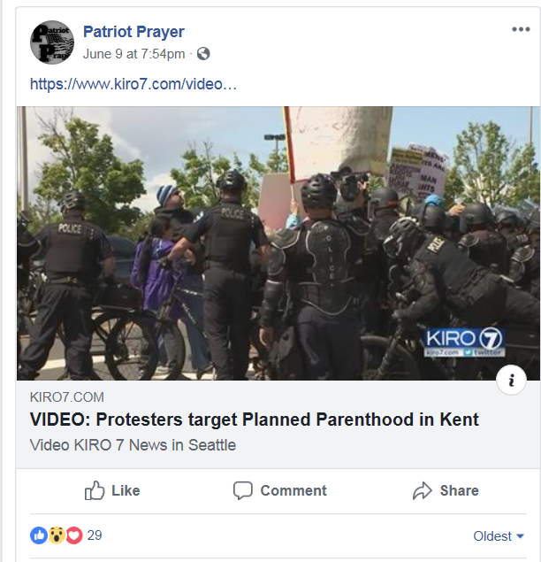
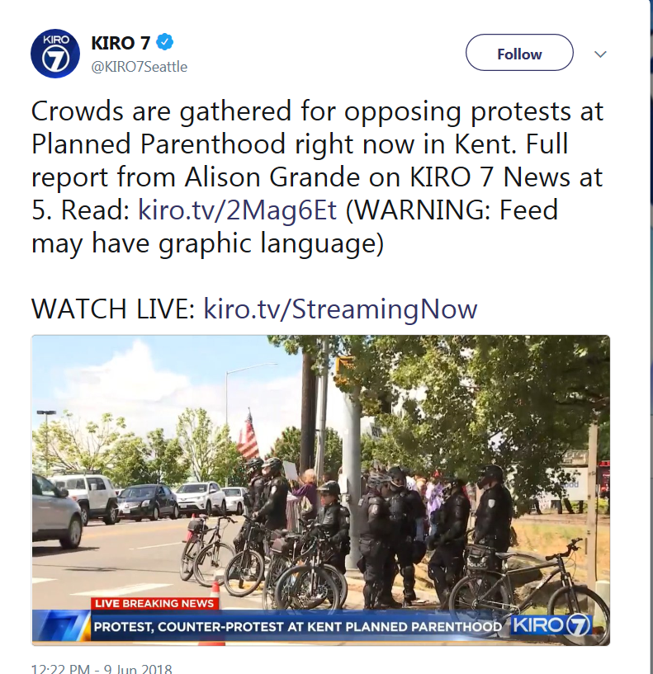
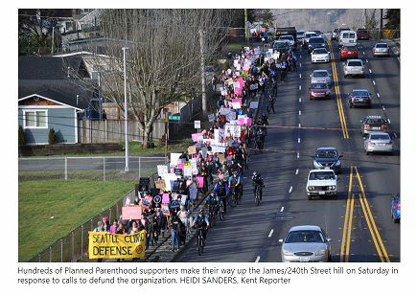

Slide 23
Lesson 3: LESSON 3: STRATEGIES TO STAY SAFEsafe. to stay safe.
Recognize situations where protest activity is taking place.
Use strategies to avoid becoming part of the event or a poster child on the evening news.

Slide 24
Security Considerations for Employees
What can employees' practice to help keep themselves, colleagues, and their organizations safe.
SITUATIONAL AWARENESS
Simply put, that means being vigilant and increasing awareness of one’s surroundings:
Pay attention to your surroundings, make observations, and draw appropriate conclusions.
Learn to key in on the unusual or on someone or something that seems out of place.
Beyond that, here are a few safety practices to keep in mind:

Slide 25
Know your employers' protocols for protest, emergencies and civil unrest
Avoid protest areas or large gatherings, if possible
Stay calm
Maintain a low profile. Avoid discussions of the issues at hand
Do not venture into or through a demonstration if faced with resistance
Actions that enhance your personal safety and security should be your sole focus
Remove all articles from your person which display wealth, to include rings, watches, jewelry, etc.
Identify the location of emergency exits and paths of egress from the area which has posed the most risk to your safety
Quickly and safely remove yourself from the area where an incident may/is/has occurred
If you find yourself caught up in a protest or riot keep to the edge of the crowd where it is safest. Try not to be identified as one of the demonstrators by keeping well away from the leaders/agitators
At the first opportunity break away and seek refuge in a nearby building, or find a suitable doorway or alley and stay there until the crowd passes
If you are caught up in the crowd, stay clear of glass shop fronts, stay on your feet and move with the flow

Slide 26
Comply with the commands of authorities
Do not in any way appear or engage in a threatening manner to authorities
Avoid targeted areas of civil unrest, protest or riot, such as, government buildings police stations (unless seeking assistance), public places, restaurants, etc.
Anticipate cell phone/landline disruption
Monitor local media, and/or other trusted sources for updates
Follow your company’s communications plan and/or evacuation process
Consider establishing a communication plan for family members
Remember the five-step process for an active shooter type situation: awareness assess the situation, consider your options (run, hide, fight) and risks, take an action
If shooting breaks out, drop to the ground and cover your head and neck, and lie as flat as you can

Slide 27
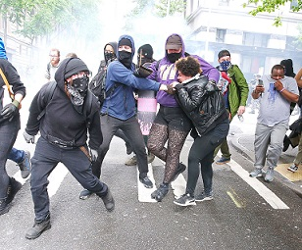
Security Considerations for Employers
Business Contingency Plans: Ensure plans are updated and tested routinely.
Crisis Management: Plan and objectives are in place prior to an event
Security Staff: both proprietary and contract security staff are up to date on policies, procedures and protocols.
Global Security Operations Center/Security Command Center: CCTV systems, access control
Planning / Ad Hoc Contract Security
Intelligence Program
Workplace Safety/Active Shooter Plan
Employee Assistance Plans
Threat Management
Communication
COVID-19 Concerns
Additional

Slide 28
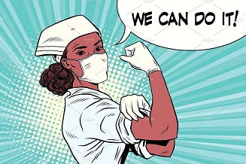
BEST PRACTICES IF YOU MUST INTERACT WITH PROTESTERS
Adhere to your organization's guidelines.
Interaction should only be attempted to defuse and de-escalate a conflict.
Always consider how the action will impact CLIENTS, visitors, co-workers.
Action should always be for the clients and NOT AGAINST the protesters (the outcome is irrelevant if you are right, and the protesters are wrong, but the client is stressed or scared.
Do not come into close physical proximity to protesters. Protesters may interrupt this action as inflammatory or confrontational.
If physical contact is made, tell the protesters clearly, “do not touch me” or “stop assaulting me.”
Ignore comments from protesters.
Do not take comments personally.
Protesters are looking for ways to encourage staff, volunteers, clients to act inappropriately.

Slide 29
Wrap-up
Protesting is a protected right.
Become fully knowledgeable of your employers' protocols for protests, emergencies and civil unrest.
The safest strategy is to avoid protests.
If you can’t avoid a demonstration or are inadvertently swept up in one:
Situational Awareness
Remove yourself from the event as soon as possible
Remember the five-step process for an active shooter type situation: awareness assess the situation, consider your options (run, hide, fight) and risks, take an action

Slide 30
Wrap-up
IF YOU MUST INTERACT WITH PROTESTERS
Interaction should only be attempted to defuse and de-escalate a conflict.
Always consider how the action will impact CLIENTS, visitors, co-workers.
Action should always be for the clients and NOT AGAINST the protesters (the outcome is irrelevant if you are right, and the protesters are wrong, but the client is stressed or scared).

Slide 31
QUESTIONS?

Slide 32
RELEVANT STATUTORY LAWS
Washington State Laws Most Relevant to Demonstrations & Protests and used by law enforcement for conduct engaging in criminal activity.
The terms misdemeanor, gross misdemeanor, and class B, or C felony correlate with the authorized maximum sentence available for each offense. A misdemeanor carries a maximum punishment of 90 days in jail, a fine of up to $1,000, or both. A gross misdemeanor carries a maximum punishment of up to 364 days in jail, a fine of up to $5,000, or both. A class C felony carries punishment of up to five years in prison, a fine of up to $10,000, or both. A class B felony carries punishment of up to ten years in prison, a fine of up to $20,000, or both.
Disorderly conduct, RCW 9A.84.030. (misdemeanor) A person is guilty of disorderly conduct if the person: (a) Uses abusive language and thereby intentionally creates a risk of assault; (b) Intentionally disrupts any lawful assembly or meeting of persons without lawful authority; (c) Intentionally obstructs vehicular or pedestrian traffic without lawful authority; or (d)(i) Intentionally engages in fighting or in tumultuous conduct or makes unreasonable noise, within five hundred feet of: (A) The location where a funeral or burial is being performed; (B) A funeral home during the viewing of a deceased person; (C) A funeral procession, if the person described in this subsection (1)(d) knows that the funeral procession is taking place; or (D) A building in which a funeral or memorial service is being conducted; and (ii) Knows that the activity adversely affects the funeral, burial, viewing, funeral procession, or memorial service.
Obstructing a law enforcement officer, RCW 9A.76.020. (gross misdemeanor) Obstructing a law enforcement officer occurs when a person willfully hinders, delays, or obstructs any law enforcement officer in the discharge of his or her official powers or duties.
Failure to disperse, RCW 9A.84.020. (misdemeanor) Failure to disperse occurs when: 1) three or more persons congregate; 2) there is conduct that creates a substantial risk of injury to any person; 3) a peace officer or other public servant who is enforcing or executing the law orders them to disperse; and 4) the person refuses or fails to disperse.
Criminal mischief, RCW 9A.84.010. (gross misdemeanor) Criminal mischief occurs when a person: 1) acts with three or more people; and 2) knowingly or unlawfully uses or threatens to use force. It also occurs if a person participates in any way in the use of such force against a person or property.
Intimidating a public servant, RCW 9A.76.180. (class B felony) Intimidating a public servant occurs when they use a threat to influence, or attempt to influence, a public servant’s vote, opinion, decision, or other official action as a public servant. Public servant means, among other things, any person who presently occupies the position of any officer or employee of government. A threat can occur in a number of ways including, but not limited to, direct or indirect communication of the intent: 1) to immediately use force against any person who is present when the threat is made; or 2) to subject the person threatened or any other person to physical confinement or restraint. Indirect communication might include conduct such as blocking a person when they attempt to leave.
Coercion, RCW 9A.36.070. (gross misdemeanor) Coercion occurs if a person: 1) by use of threat (see definition above); 2) compels or induces a person to engage in conduct which the latter has a legal right to abstain from, or abstain from conduct which he or she has a legal right to engage in.
Unlawful imprisonment, RCW 9A.40.040. (class C felony) Unlawful imprisonment occurs if a person knowingly restrains another person. Restrain means to restrict a person’s movement without consent and without legal authority in a manner which interferes substantially with his or her liberty. Restraint is "without consent" if it is accomplished by physical force, intimidation, or deception.
Assault in the fourth degree, RCW 9A.36.041 (gross misdemeanor) (1) A person is guilty of assault in the fourth degree if, under circumstances not amounting to assault in the first, second, or third degree, or custodial assault, he or she assaults another. An assault is an intentional touching, striking, or cutting of another person that is harmful or offensive regardless of whether any physical injury is done to the person. It is not necessary that bodily injury be inflicted for an assault to occur. An assault can also be committed when a person, with the intent to create in another apprehension and fear of bodily injury, and which in fact creates in another a reasonable apprehension and imminent fear of bodily injury even though the actor did not actually intend to inflict bodily injury.

Slide 33
RELEVANT STATUTORY LAWS
First Amendment
The First Amendment to the U.S. Constitution
Although peaceable assembly is protected by the U.S. Constitution, reasonable limitations on time, place, and manner of speech are upheld by the courts as seen in the cases of Bay Area Peace Navy v. U.S. (1990); Frisby v. Schultz (1988); Schenck v. Prochoice Network (1997); Walker v. City of Birmingham (1967); Hill v. Colorado (2000); United States v. Scott (1999); Cox v. New Hampshire (1941); Heffon v. International Society for Krishna Consciousness (1981); Snyder v. Phelps (2011); Tobey v. Jones (2013); and Ward v. Rock Against Racism (1989). Key issues include:
(a) The First Amendment protects the right to peaceably assembly and freedom of speech.
(b) The courts have set time, place, and manner of speech restrictions on both the right to assemble and freedom of speech.
(c) A common form of time, place, and manner of speech restrictions take the form of local parade permits
(d) Restrictions are justified as long as the restrictions are without reference to the content of regulated speech.
(e) Restrictions must be narrowly tailored to serve a significant government interest.
(f) Restrictions must leave open ample alternative channels for communication of the information.
Freedom of Access to Clinic Entrances (FACE) Act of 1994, 18 U.S.C. § 248. The 1994 Freedom of Access to Clinic Entrances (FACE) Act states whoever (1) by force or threat of force or by physical obstruction, intentionally injures, intimidates or interferes with or attempts to injure, intimidate or interfere with any person because that person is or has been, or in order to intimidate such person or any other person or any class of persons from, obtaining or providing reproductive health services; (2) by force or threat of force or by physical obstruction, intentionally injures, intimidates or interferes with or attempts to injure, intimidate or interfere with any person lawfully exercising or seeking to exercise the First Amendment right of religious freedom at a place of religious worship; (3) or intentionally damages or destroys the property of a facility, or attempts to do so, because such facility provides reproductive health services, or intentionally damages or destroys the property of a place of religious worship is subject to criminal penalties under this law and subject to civil remedies.
Buffer zones (often an issue with abortion clinic), are valid as long as they allow for alternative channels for communication of the information. In McCullen v. Coakley (2014), The Supreme Court Ruled that the Massachusetts statue that imposed a 35- foot-fixed buffer zone; to include sidewalks, driveways, and roadways; violated the First Amendment. While the state had a valid concern to maintain public safety on the streets and sidewalks, the state could not close these off from protesters because the sidewalks and streets have always been a traditional public forum for speakers.

