Slide 1


Slide 2

WA Association for Community Health
Health Disparities in Hypertension and Diabetes
April 17, 2019

Slide 3
Outline
Methods
Diabetes literature methods for SDoH impacts on Hba1c
Hypertension literature review on which SDoH factors are being researched
Literature review
Findings
SDoH Impacts
Diabetes
Hypertension
Interventions, surveys and projects
Creating a causal model
Designing a screening that addresses multiple projects
Aim of this webinar is to provide a useful reference guide for intervention development, SDH survey implementation and other QI projects.
First ever image of our data black hole
Notes:
Compliments of Hannah

Slide 4
HRSA Diabetes QI Initiative
The measures for the QI initiative are: Reduce by 1% the disparities gap between racial and ethnic groups with the highest and lowest rates of diabetes by year 2020.
HRSA also aims to by 2020, increase the number of health centers that meet the Healthy People 2020 goals for uncontrolled diabetes for each racial/ethnic group.
Source: HRSA, Health Center Program Diabetes Quality Improvement Initiative. Accessed 10/07/2019 https://bphc.hrsa.gov/qualityimprovement/clinicalquality/diabetes.html
Notes:
Why did we choose 2016 UDS data? Because 2016 was a relatively stable year in terms of confounders. This will provide us with the best information on expected magnitudes of differences assuming the best access to care, insurance and stable measures. How can we use UDS in the future to address these initiatives? We can use the same methods for each year of UDS data to determine if each health center has met the QI initiative and if the health centers in WA as a whole have met the goals of the initiative. We can use this data to determine what SDoH factors might be more common among racial or ethnic groups that will help with culturally competent care.

Slide 5
Literature Review Findings
The relationship between Social Determinants of Health interventions and diabetes is not always straightforward and may include multiple risk factors.
The gap between domains covered on SDoH screening tools and the research on risk factors for hypertension is wide.
Notes:
Are our findings consistent with national findings? Yes, although some questions about disparities remain. For example, in WA Asian Americans were more likely to have a diagnosis of diabetes but they were also more likely to have better control. American Indians/Alaska Natives were more likely to have a diagnosis of diabetes but fared better in terms of control at non-native clinics. While this is possible a data artifact, we should also consider the possibility that Native Americans/Alaska Natives being served at INH clinics are more complex and have different SDoH risk factors that contribute to their health outcomes.

Slide 6
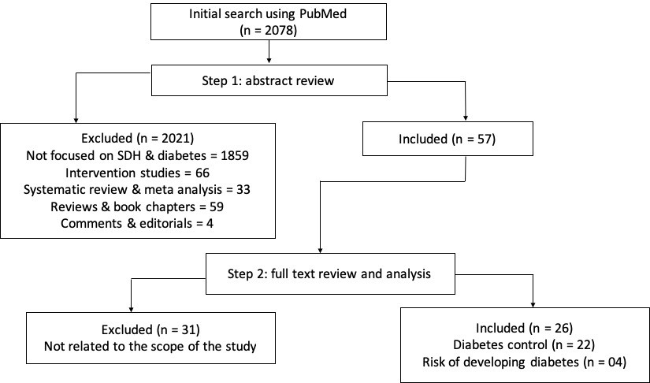
What did we do?
PRISMA search strategy for Diabetes
We looked at the literature on Diabetes and Social Determinants of Health/Social Needs risk factors and included research that provided information on the impact a social determinants intervention had on the control of diabetes or the risk of developing diabetes.
Notes:
We have been developing a data strategy in order to operationalize a core function identified in the boards strategic plan, to address questions our organization wishes to answer and to identify areas for improvement.
A data strategy connects specifics, for instance. ‘what measure should I use to track opioid prescription’ with overarching considerations ‘how does that support organizational goals or objectives. A good data collection effort should always start with a question that is specific and measurable.

Slide 7
What did we do?
We looked at the literature on Hypertension and Social Determinants of Health/Social Needs risk factors in two ways: First, whether or not the risk factors being investigated were collected using a validated in-clinic survey tool, and second, whether or not the risk factor domains aligned with the PRAPARE tool.
Initial Search
(N=1041)
Review 1:
Abstract review for types of data collection
Did not use standardized and validated screening tool in the clinic
(N=1022)
Used standardized and validated screening tools in the clinic
(N=19)
Review 2:
Abstract review for risk factors aligned with PRAPARE
Not aligned with PRAPARE:
Cigarette smoking (227)
Alcohol use (103)
Sleep Quality (28)
Air pollution (3)
Digital connectedness (1)
Aligned with PRAPARE
Stress (79)
Neighborhood (49)
Food quality/food insecurity (32)
Health Literacy (24)
Domestic violence (4)
Acculturation (9)
Notes:
Data Analytics has been identified as a “Core Function” in The Association’s Strategic Framework. That means that Data Analytics and improvement touches all areas of work the Association does. The idea behind operationalizing this core function is that we can build long-term capacity within our organization.

Slide 8
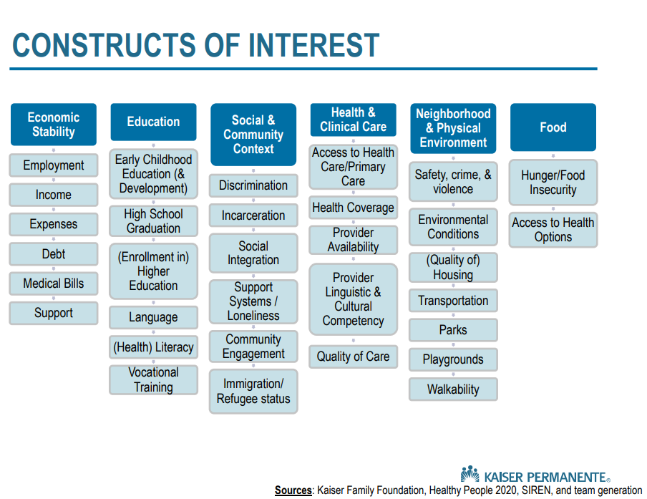
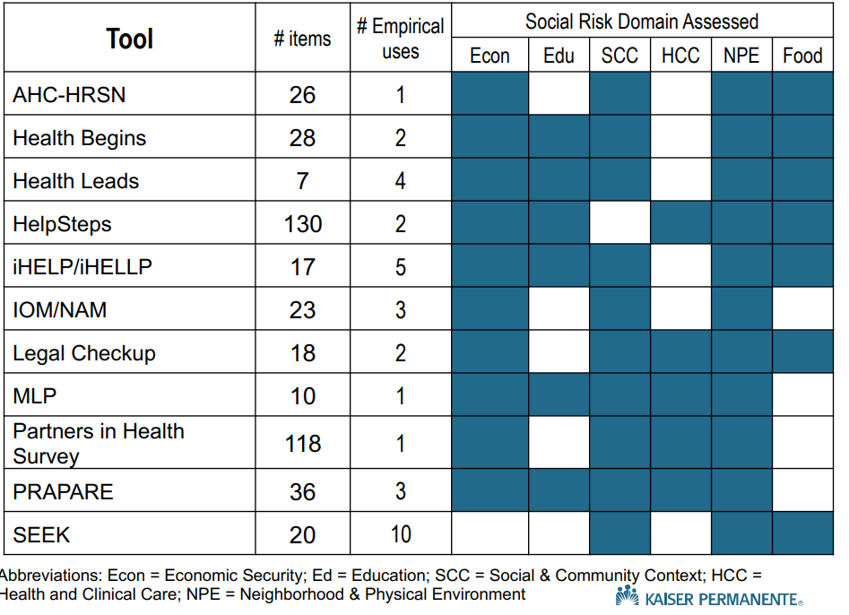
Common tools and constructs they cover
This review of tool constructs can be found at: https://sirenetwork.ucsf.edu/sites/sirenetwork.ucsf.edu/files/SIREN19_Lewis.pdf
Notes:
This is an overview of Kaisers research on construct validity for SDH screening tools. While it demonstrates that PRAPARE is one of the more comprehensive and valid tools available. However, as we will see no single SDH screening tool currently covers all the risk factors being researched

Slide 9
Surveys
Notes:
Tools found in our Hypertension literature review included some uncommon ones like WHO Steps, social needs surveys specifically developed for studies, surveys specific to populations of interest, and tools for measuring stress or depression specifically.

Slide 10
Surveys and Domains
This literature review demonstrates that a single survey tool like PRAPARE may not provide enough information to develop effective social needs interventions for patients with Hypertension or Diabetes.
Notes:
Domains covered by the most common tools (WHO Steps and PROMIS) compared with PRAPARE.

Slide 11
Gaps in SDoH Interventions for Hypertension
Measures that researchers in this review were interested examining as risk factors for hypertension, but which are missing from the SDoH tools in general:
Religious affiliations
Digital literacy/connectedness
Vaping (as opposed to smoking)
Cultural trauma
and disability
Measure missing from PRAPARE, in particular:
Sleep
Literacy/health literacy (as opposed to just education level)
Acculturation
Culture associated risk behaviors (such as smoking, alcohol, and diet)
Air quality
Sex/Gender
Physical Activity
Sexual function
Marital Status
Notes:
It is difficult to glean some of these more specific measures from the broader domains or constructs that social needs screening tools cover.

Slide 12
SDOH associations with Diabetes
Social Needs/Social Determinants domains with direct associations to diabetes control:
Food Insecurity
Employment
Education
Nativity
Social Needs/Social Determinants domains with indirect associations or effect modifiers. These were strongly associated with other risk factors such as age, safety and poverty:
Stress
Insurance status
Social Support
Race/Ethnicity
Social Needs/Social Determinants that were not found in this literature review:
Geography
Urban/Rural Status
Incarceration

Slide 13
SDOH associations with Hypertension
Marital Status
Economic Stability
Neighborhood /Physical Environment
Stress
Social Needs/Social Determinants domains with direct associations to Hypertension control:
Stress
Air quality
Physical activity
Sleep
Health literacy
Acculturation
Religious affiliations
Digital literacy
Disability
HYPERTENSION
Notes:
These risk factors may fall under multiple domains or constructs. How do we know that the domain or construct we are measuring on a Social Needs survey is the one that is contributing the most to the risk factors for disease?

Slide 14
Impact of SDoH on Diabetes
Patients of Hispanic ethnicity who speak English very well are more likely to develop diabetes
Food security is a major factor in glycemic control
Stress from multiple domains such as socio-economic, gender-based discrimination, lack of social support and depression all have similar effects on a patient's ability to control their diabetes.
While the relationship between social status and glycemic control is unclear, education and income are strongly associated with glycemic control.
Having Medicaid, as opposed to being uninsured, is associated with better quality of care and better outcomes for glycemic control.
Race and ethnicity are confounded by the distribution of other SDoH factors such as social support, geography or health literacy.
Notes:
These impacts tell us that thinking about things like food security may not be necessarily enough. Should we be asking ourselves if the concept of food security is itself a biased construct? A family tradition of cooking, cooking skills, or time to cook may be a much more important lens for thinking about care plans. When we look at the impact's social needs on Diabetes, for instance, we see that people who are more engaged in Hispanic or Asian culture are less likely to develop or better able to control their disease. Insert poll – How would you interpret this evidence based on what you know about the make-up of your clinic's population?

Slide 15
What does it mean?
Nativity
Food insecurity
Gender based discrimination
Socio-economic status
Depression
Stress
Lack of social support
Discrimination
Race
Ethnicity
Insurance status
Diabetes development
Insurance status
Diabetes control
Notes:
When we start to collect data we can develop our own models of how we think these factors are interrelated in order to draw a more clear picture of which one is most important to address in our community using a social needs survey. For example, in both of these models, Insurance status is a major factor in both diabetes development and control. While this may seem obvious, it is important to note that it is not completely independent of other factors. Addressing other SDH needs like discrimination or stress, in addition to insurance status, may be the most effective plan for reducing poor population health outcomes.

Slide 16




Minding the Gaps
Because the factors listed on the previous slide are considered risk factors or protective factors for hypertension and are also associated with modifiable or mutable SDoH domains, they are important considerations for inclusion in any SDoH screening at the clinic level.
Notes:
The question for providers and community health centers is how to mind the gaps between evidence-based practice and social needs surveys. Is the data you need still collected in your EHR and can it be added to a report? If this data is not collected in your EHR, how important is it to get it and how do you propose to collect it at the patient level? There are other, harder to define measures, that are missing as well. In other words, it is just as important to look at the social factors and social needs of those without the disease in order to discover what the fundamental issues are for our specific populations. Minding the gaps is a case for systematic, comprehensive social needs screenings regardless of whether your clinic can currently or individually address the needs of your patients. The data is the important first step in closing the gaps of social needs in order to improve population health outcomes.

Slide 17
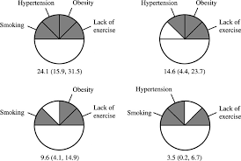
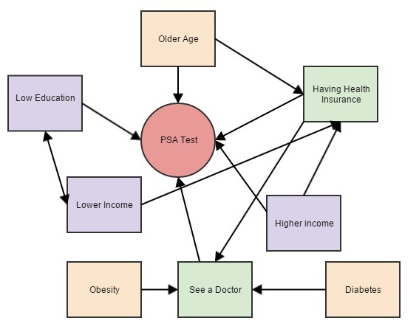
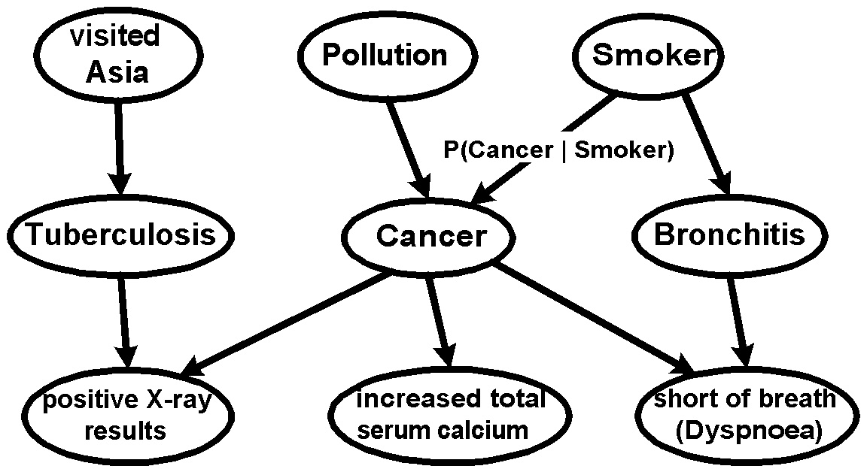
Causal Models
Sufficient Cause Interventions
The removal on one component may interfere with the action of others and thus prevent disease
Necessary – found in all cases
Contributing – needed in some cases
Sufficient – a constellation of causes that make disease inevitable
Necessary and Sufficient
without the factor disease will not develop
With the factor the disease will always develop
Necessary but not sufficient
Factor present, but low dose
Part of a group of multiple factors
Notes:
Causal models are complex and interrelated. A cause is termed sufficient when it is inevitable/certainty produces or initiates a disease. Sufficient means a combination of factors that are often interrelated and consist of multiple components. The aim of developing a good social disparities surveillance program is to identify the components that contribute to disease, the amount of influence/dose that factors on the development or control of the disease, and ways in which the influence of those components can be mitigated or removed in the clinic. The causal model for your clinic's population may look different than the causal model for other populations. For example, pollution may play a larger role in the development of lung diseases than smoking does in your area.

Slide 18
How does this inform us?
Priority Topics
Health Disparities, SDH, APM4, Workforce
Data Capacity
Data elements needed, access, analytics, comparison points, storage, integration, governance, dissemination ...
Audiences and uses
NACHC, Workforce Committee, Executive Committee, HRSA, other CHC Medical Directors, BOD, Legislators,
The Hypertension and Diabetes Study, can:
inform us about what might be worth focusing on for QI work around Hypertension and Diabetes
inform us about which SDH measures need more work on reliability and validity
demonstrate how ready clinics are (or not) to use SDH measures in VBP
help determine what kinds of positions might need to be hired for or trained to address SDH
help us assess the strengths of CHC’s resource and referral relationships and the validity of the work those referrals do.
STUDY
Notes:
Thinking back to slide 15 we see how this literature review can a) inform us of the most studied or most important factors in disease control, b) design screening that focus on factors instead of populations (insurance status and depression for all patients), and c) implement an intervention based on survey findings with those who have specific diseases. These literature reviews may also help quantify needs for increased capacity such as staffing, data analytics, data elements/storage/workflow or demonstrate readiness for participation in projects.

Slide 19
Burden Reduction
Current collection methods
Dental | Workforce | Opioid
Asks about staffing | Asks about staffing | Want to ask about staffing
Bi-annual | Annual | TBD
Current staff, new staff – hired in the last 6 months | All staff for CY with hire dates and termination dates | TBD
Includes EFDAs, Admin staff, | Does not include EFDA’s, Admin staff | TBD, want to ask about MAT waivered providers
Reported annually? | Reported annually | TBD
12 variable asked, aggregate | 13 variables asked, individual on all staff | TBD, at least one additional variable
19 participating clinics, 8 actually reporting | 27 participating, 17 partially or fully reporting | TBD
Proposed collection methods
Staffing
Asks about staffing
Annually
All staff for CY with hire dates, termination dates, (can calculate rates over time)
Includes all UDS staffing categories plus any administrative categories needed
Reported annually
8-17 variables, individual, PPS sampling
27 participating, 10-15 selected randomly to participate
Notes:
Here is a more specific example of how we can accomplish a reduction in reporting burden and an increase in strategic data collection. In discussion around the HR metrics collection, for example, we have had little discussion about other areas in which we also collect staffing information. Instead, the conversation has focused on how many variables should be collected. As you can see from this example, a reduction in the number of variable in one collection effort doesn’t necessarily reduce the overall collection burden all that much. A better approach is to focus on consolidating the variables for “staff” from all areas of work into one collection effort. By using random and PPS sampling we can further reduce the report burden. In this example, Dental and Opioid measures would only be filled out for clinical measures, not for staff measures, reducing the need to pass another report to HR staff every 6 months. We don’t need to ask how many Dentists have been hired exactly; by collecting hire and separation dates, we can estimate how many new staff were hired within the period that a new operatory was built. When we compare the estimates of new staff in a certain period to new patients within that same period (from Dental clinical measures) we can then describe whether there was and increase or decrease in ‘capacity’.

Slide 20
External Needs
Organizing and validating what we already know about CHC’s capacity into a neat, accessible package in something like Airtable or Access
Deciding what is important for our organization, as a whole, to know about our CHCs
Developing a set of questions to have “in our pocket” that we might ask CHC’s about their data capacity, in the future when we have more focus
Notes:
Part of increasing our internal capacity includes make “core” CHC data available to everyone in the office. This might include things like information from our environmental scan and some UDS questions. Deciding what other easily accessible information we might want to know about our CHCs is also important, this might include things like who is submitting to the state HIE and who is exchanging information – things we don’t necessarily have to ask our CHC’s about but can find out on our own. Finally, we should develop a set of questions that we want to ask our CHC’s directly about their data capacity. We might use these questions to update our environmental scan or as the basis for a new or revised data collection effort. Our strategy is to move this data to more sharable formats like Access or Airtable.

Slide 21
Questions and Comments

Slide 22
Difference between reporting and analysis
Notes:
Reporting is just one part of a data strategy. Analysis is another important part and serves a different function than reporting, although both require data as an input and have an action as an outcome. This is an example of how report and analysis are different from each other.

